Slide 1


Quality Dashboards:
by Raina Bagewadi

Slide 2
Understanding Quality Dashboards
Data-Driven Insights
Visualizations & Analysis
Actionable Intelligence
Quality dashboards provide data- driven insights into key performance indicators (KPIs) related to product or service quality.
They present data visually through charts, graphs, and other interactive elements for easy analysis and interpretation.
Quality dashboards help identify areas for improvement and support informed decision-making to enhance quality standards.

Slide 3


Connecting Data Sources and Transforming Data
Data Extraction
Extract raw data from various sources using connectors and
scripts.
Data Cleaning & Transformation
Clean and transform data using Power Query Editor to ensure data quality and consistency.
Data Loading & Modeling
Load the transformed data into Power BI and create data
models to establish relationships between tables.

Slide 4
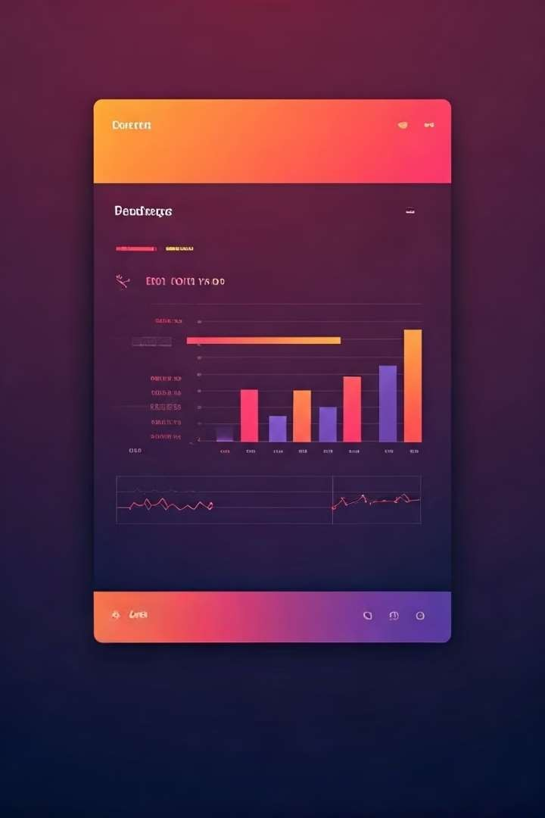
Implementing Interactive Filters and Slicers
Slicers | Filters
Allow users to select multiple values for filtering data. | Provide a dropdown menu to select a single value.
Typically displayed as buttons or dropdowns. | Often used for single-selection criteria.
Used for segmenting data by specific categories. | Ideal for drilling down into specific data points.

Slide 5

Visualizing Data Trends
1
Trend Analysis
Analyze historical data to identify patterns, trends, and
potential areas for improvement.
2
Data Forecasting
Predict future trends using statistical models to proactively address potential quality concerns.

